Slide 1
Hightower Trail Elementary School Georgia Milestones Parent Meeting Mrs. Coachman-Wright, Ed.S., Assistant Principal February 6, 2020

Slide 2
I need two volunteers.

Slide 3
Georgia Milestones
The Georgia Milestones Assessment System (Georgia Milestones) is a comprehensive summative assessment pro​gram spanning grades 3 through high school.
Georgia Milestones measures how well students have learned the knowledge and skills outlined in the state-adopted content standards in English language arts, mathematics, science, and social studies.
Students in grades 3 through 8 take an end-of-grade assessment in English language arts and mathematics while students in grades 5 and 8 are also assessed in science and social studies.

Slide 4
I need two volunteers.

Slide 5
State Board Rules
State Board Rules relating to assessment include:
160-3-1-.07 Testing Programs – Student Assessment
160-4-2-.11 Promotion, Placement, and Retention
160-4-2-.13 Statewide Passing Score
160-4-2-.20 List of State-Funded K-8 Subjects and 9-12 Courses
160-4-2-.31 Hospital/Homebound (HHB) Services
160-4-2-.34 Dual Enrollment and Move On When Ready
160-4-2-.06 through 160-4-2-.48 (IHF) High School Graduation Requirements
160-4-5-.02 Language Assistance: Program for English Learners (ELs)
160-4-8-.12 Alternative Education Programs
160-4-9-.07 Charter Systems
160-5-1-.07 Student Data Collection
160-5-1-.14 Transfer of Student Records
160-5-1-.15 Awarding of Units of Credit and Acceptance of Transfer Credit and/or Grades
160-5-1-.33 Strategic Waivers and Title 20/No Waivers School Systems
160‐7‐1‐.01 Single Statewide Accountability System
http://www.gadoe.org/External-Affairs-and-Policy/State-Board-of-Education/Pages/PEABoardRules.aspx

Slide 6
Opting Out
The state requires that all students participate in state mandated testing.
No third, fifth or eighth grade student shall be promoted to the next grade if the student does not achieve grade level on the state-adopted assessments in reading (grades 3, 5, and 8) and mathematics (grades 5 and 8) and meet promotion standards and criteria established by the local board of education for the school that the student attends.

Slide 7
Opting Out
Local Promotion Criteria
The student must pass five out of five academic subjects including English Language Arts, Reading, Mathematics, Science and Social Studies.
AND
The student must achieve a grade level reading determination of “On/Above Grade Level” on the End-of-Grade Reading Assessment AND attain an achievement level of “Developing Learner”, “Proficient Learner”, or “Distinguished Learner” on the Mathematics section of the state adopted End-of-Grade Assessment and meet the local promotion criteria established by the Rockdale County BOE in order to be promoted to the next grade level.

Slide 8
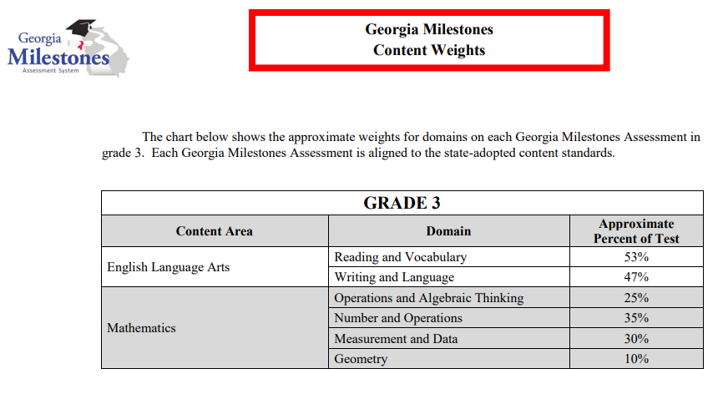

Slide 9
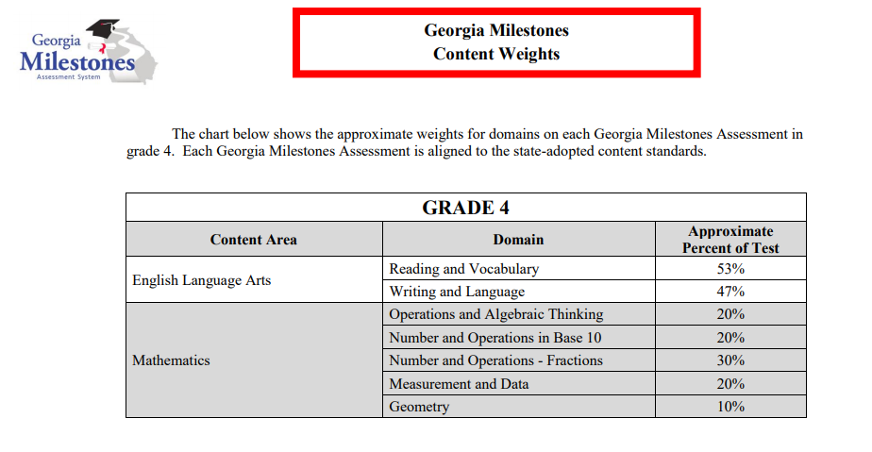

Slide 10
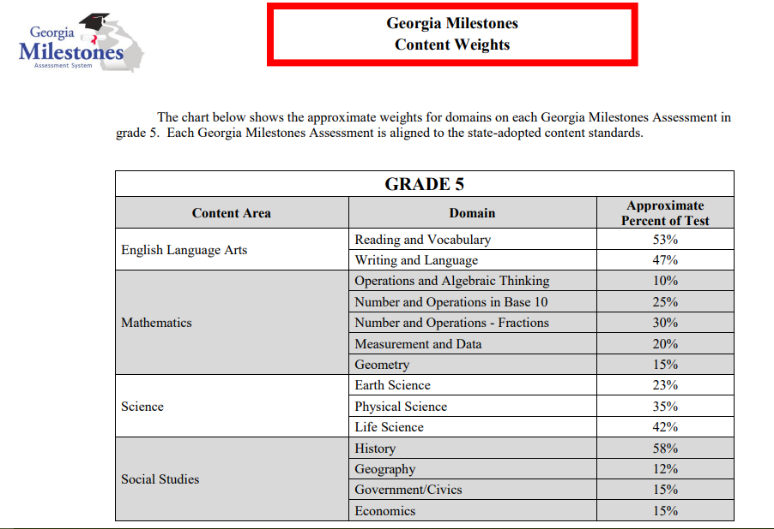

Slide 11
English Language Arts Five Item Types on Georgia Milestones (GMAS)
Multiple Choice
Part A/Part B
Short Open Ended
Narrative Task (Story)
Essay

Slide 12
Question Format by Section
 | Section 1 Day 1 | Section 2 Day 2 | Section 3 Day 3
Time | 70-90 Minutes | 70-85 Minutes | 70-85 Minutes
Question Types | 2 Passages 3 Selected Response 1 Constructed Response 1 Extended Writing (Essay) Informative/Explanatory OR Opinion/Argumentative | Several Passages 27 Selected Response 1 Constructed Response 1 Extended Constructed Response (Narrative Prose) | Several Passages 27 Selected Response 1 Constructed Response 1 Extended Constructed Response (Narrative Prose)
Notes:
ES/MS 3 days for ELA
HS-2 days for ELA
The test format is the same for English Language Arts in all grade levels. The content and expectations for mastery increase in complexity from one grade level to the next.

Slide 13
Question Type 1: Multiple Choice
Which sentence BEST states the main idea of the passage?
A. Though Galápagos tortoises used to live only on some islands, they are now found in many places.
B. People are helping the Galápagos tortoises in many ways so that the number of tortoises is going up.
C. Removing goats from the islands of Galápagos tortoises has helped increase the food supply for tortoises.
D. Galápagos tortoises and turtles are similar, but turtles have not experienced as many problems as tortoises.
Notes:
(Selected Response)
Provides answer choices
One Point (per answer)
Most common

Slide 14
Question Type 2: Part A/Part B
This question has two parts . Answer Part A, and then answer Part B. ​
​Part A: How does the poet develop the character of the carpenter in the poem “The Carpenter”? ​
A . The poet uses short, powerful, rhythmic lines . ​
B . The poet outlines the sequence of steps to build a home. ​
C . The poet uses phrases like “keen eyes” and “inner smile.”​
D . The poet describes working with “blueprints” and “beams.” ​
​
Part B: Which line from the poem BEST supports the answer in Part A? ​
A . He cuts and shapes with vision. ​
B . He converts the lines and numbers ​
C . Pounding rhythms to his own beat . ​
D . Walls and windows, floors and doors.
Notes:
(Evidence Based Selected Response)
Has two parts
Part A will ask an inference question about the text.
Part B will ask you to identity evidence from the text that supports your answer to Part A.​
Worth Two Points
If you answer both Part A and Part B Correctly=2 points​
If you answer only Part A Correctly= 1 point​
If you do not answer Part A Correctly= 0 points

Slide 15
Question 3: Open Response
Describe the theme of the passage. Be sure to use details from the passage to support your answer.
Notes:
(Short Constructed Response)
Asks students to write a short-constructed response to a question and include details from the text that support the answer.
Answer must include at least 2 details from the text.
ACE Strategy
Two Points

Slide 16
Question 4: Narrative Task
The story ends with Martin telling his friends he is moving to another city. Finish the story by writing about Martin’s first day at his new school.
Notes:
(Extended Constructed Response)
Asks students to revise a story (literary) or write an original story based on a topic similar to the text (informational) read.
Four Points
Rubric Score

Slide 17
Question 5: Essay
Weigh the claims on both sides, and then write an argumentative essay in your own words, supporting one side of the debate in which you argue EITHER that smartphones should be allowed in the classroom OR that schools should be smartphone-free.
Be sure to use information from BOTH passages in your opinion (argumentative) essay.
Notes:
(Extended Writing Response)
Students must write an opinion/argumentative essay
OR
an informational/explanatory
essay
Students must write the type of essay assigned
Seven Points
4 Content
3 Grammar

Slide 18
Five Item Types on Georgia Milestones (GMAS)
Multiple Choice
Part A/Part B
Constructed Response – 2 pts
Narrative Prompt – 4 pts
Essay – 7 pts (informational/explanatory

Slide 19
Scoring
Scale Score
Beginning
Developing
Proficient
Distinguished
Two Domains
Reading and Vocabulary 53%
Writing and Conventions 47%
Reading Status
At or Above Grade Level
Below Grade Level
Notes:
RDG/VOC 53%
Writing/Lang

Slide 20
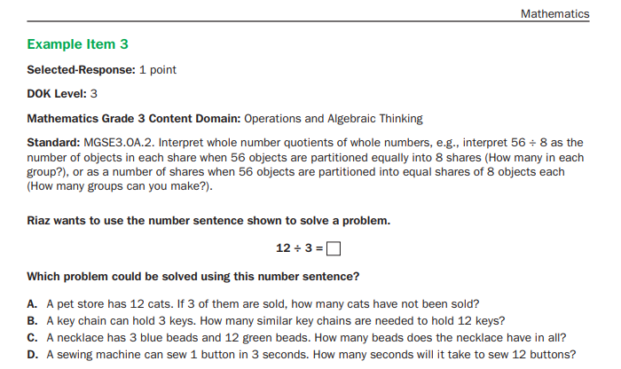
Mathematics Item Types

Slide 22
Cell Phones and Electronic Devices
No electronic devices that could allow students to access, retain, or transmit information (e.g., cell phone, smartphone, smartwatch, PDA, electronic recording, camera, or playback device, etc.) allowed in the testing environment.
Announcements must be made prior to testing that such devices are not allowed in the testing environment and possible consequences for possession. Examiner’s script provides reminders
Review guidance on this subject in the Student Assessment Handbook
Should a student be found in possession, the GaDOE will determine if the assessment should be invalidated based on findings of the district’s investigation.

Slide 23
GA DOE Resources
EOG Resources (Grades 3-8)
EOC Resources (Grade 9 Lit, Amer Lit)
Parent Study Guides
EOG
EOC
Practice Website for Technology Tools
http://www.gaexperienceonline.com/

Slide 24
Georgia Milestones
EOG Resources
EOC Resources
Milestones Presentations
Milestones Training Videos
GOFAR
eDIRECT

Slide 25
What can I do to help my child?
ELA
Read 20 minutes a night (ALL READING COUNTS!!!)
Ask your child to create an alternate ending for his/her favorite movie
Read aloud to your child or listen to audio books together
Have siblings read to each other
Ask children to look up "Best 10 Lists" on device and read them to you as you're driving
Ask children to read the directions for a recipe, ingredients on a box, etc.
Review Greek and Latin word parts with your child
Math
Math Fact Fluency each night
Ask them math related questions and ask them explain their answers
Practice word problems (2 and 3 step problems
Practice mental math using store receipts
Collect, organize and sort materials and put them into a chart or graph and generate questions
Gas station math problems using the price per gallon
Have students follow recipes and convert units

Slide 26
Testing Calendar
Spring Break- April 6-10, 2020
Tuesday, April 14, 2020 ELA-Section 1 (Essay)
Wednesday, April 15, 2020 ELA-Section 2
Thursday, April 16, 2020 ELA-Section 3
Friday, April 17, 2020 Make-ups
Monday, April 20, 2020 Math-Section 1
Tuesday, April 21, 2020 Math-Section 2
Wednesday, April 22, 2020 Science Section 1 & 2 (Grade 5 only)
Thursday, April 23, 2020 Social Studies 1& 2 (Grade 5 only)
Friday, April 24, 2020 Make-up
No student devices will go home over
Spring Break.

Slide 27
Q&A

